Slide 1

Inner Circle
Iteration 2
MET CS 673 Professor Yuting Zhang
Team 1 : Wasupol, Peter, Ananya, Michael, Raef, Jian

Slide 2

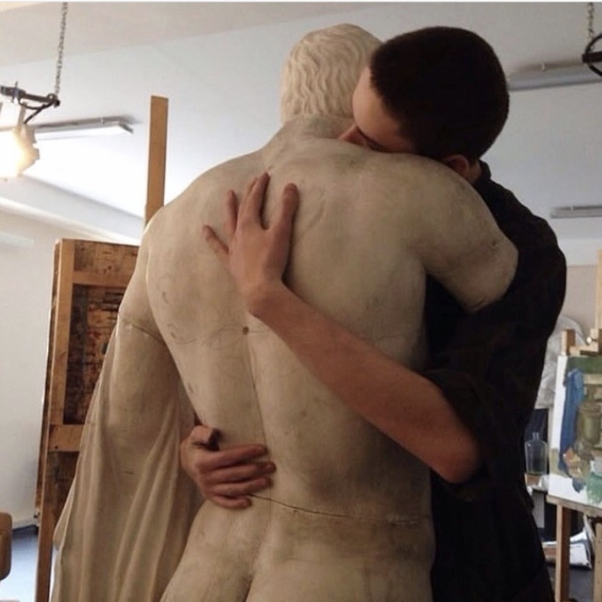
Project Overview
With so many social media and applications,
We still long for intimacy, privacy, and communication with our inner circles such as our close friends and loved ones.
We share our readings, music, opinions, and daily stories freely, We feel the same feel of our close ones, we feel that we are connected.
Here, we are a concrete person instead of a mixture of tags, titles, or fancy pictures.
Target audience: high school and college students, urban youth, and young professionals...
Notes:
Jian Ma - speaking
Storyboard?

Slide 3
Requirements Analysis
Backend Design
Update Login UI: Added logo and tested functionality. Story is complete.
Query new friend by email (As of now, we have ability to search for new friends, not add; submitted merge request)
Connect queried friend to new chat room (integrating)
User Notifications (pending)
Add profile picture (pending)

Slide 4
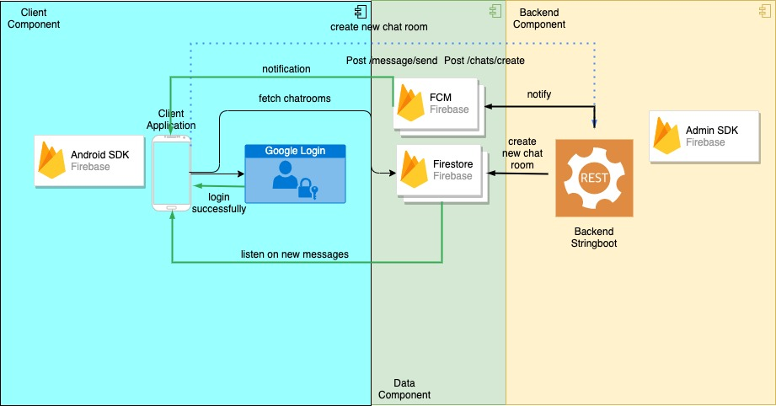
System Architecture (current)

Slide 5
Backend Implementation
Using Spring Book Java API (Restful) to do heavy load of CRUD operation
Avoid duplication
Additional core logics are implemented

Slide 6
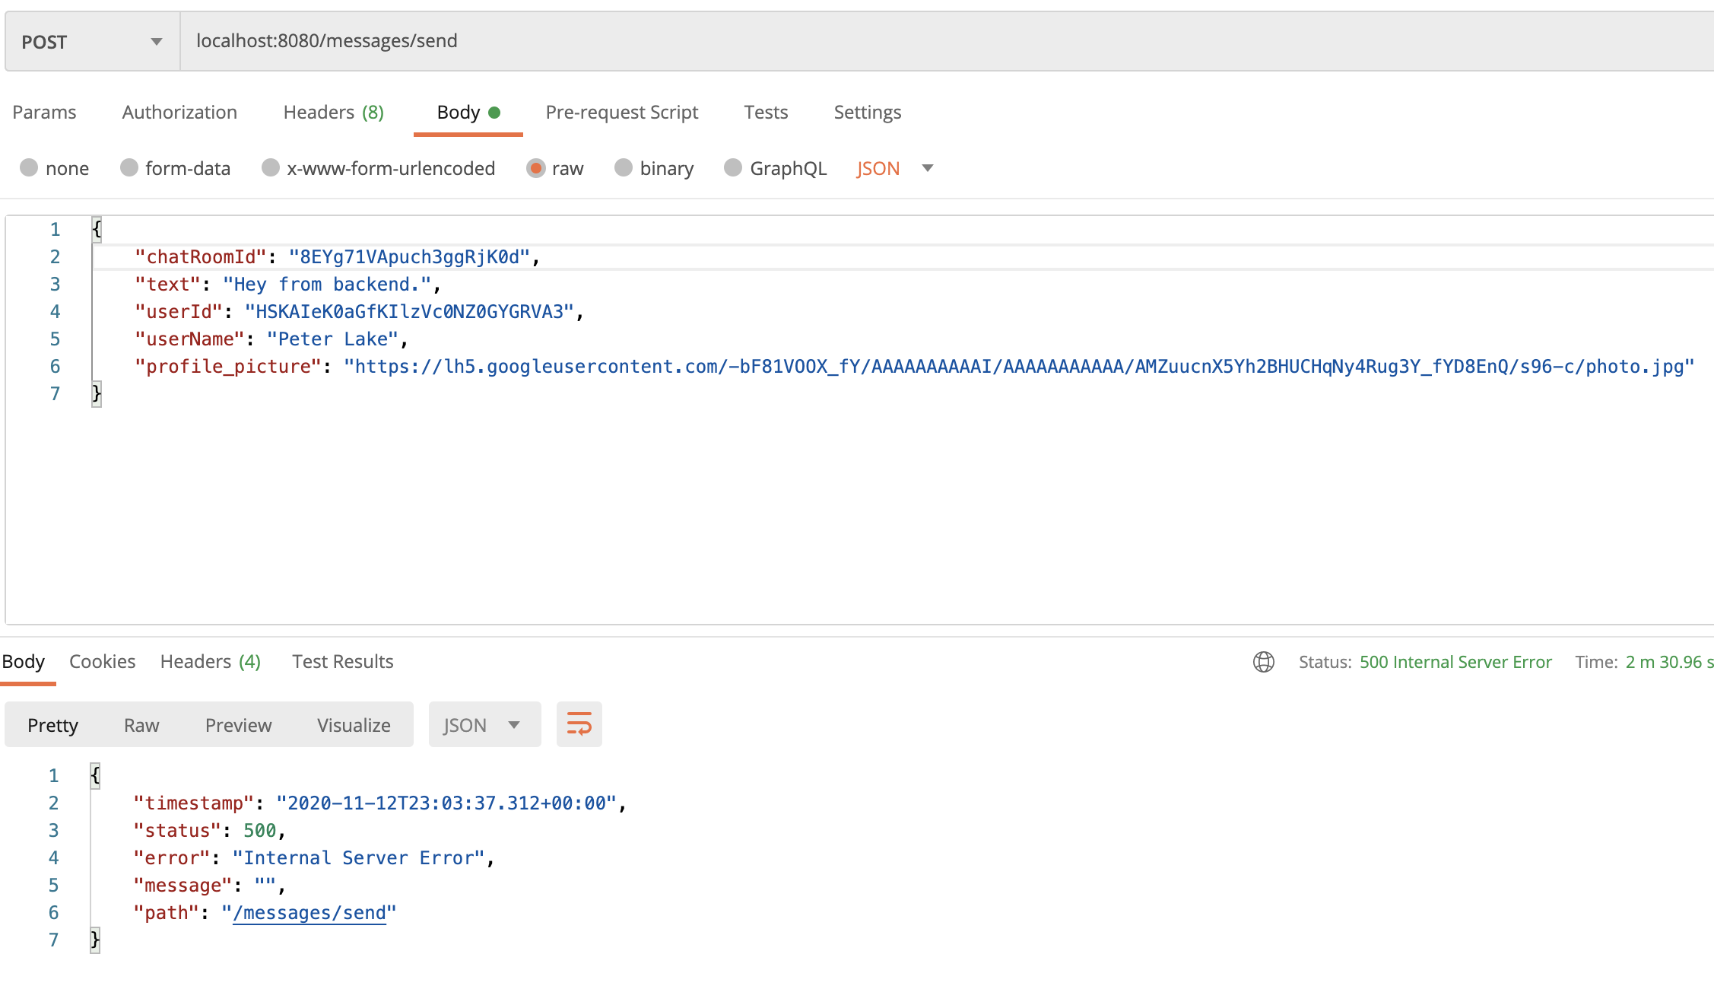
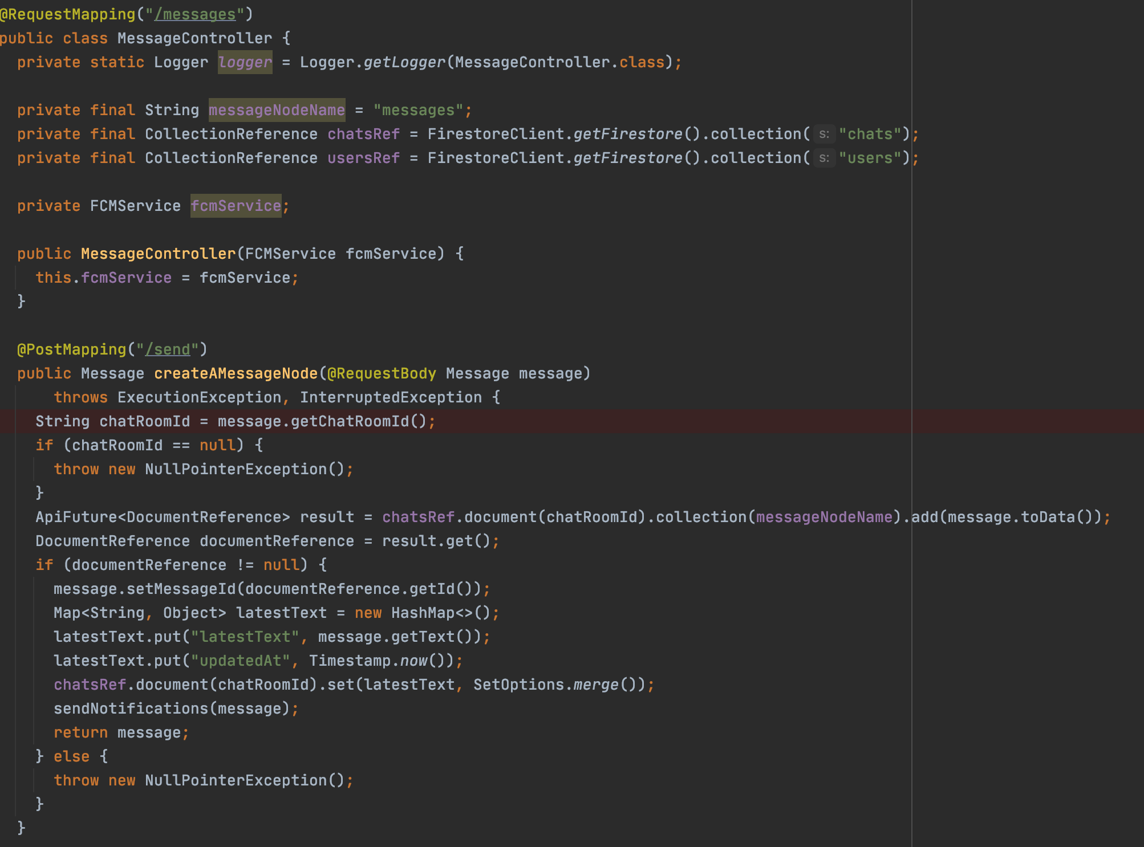
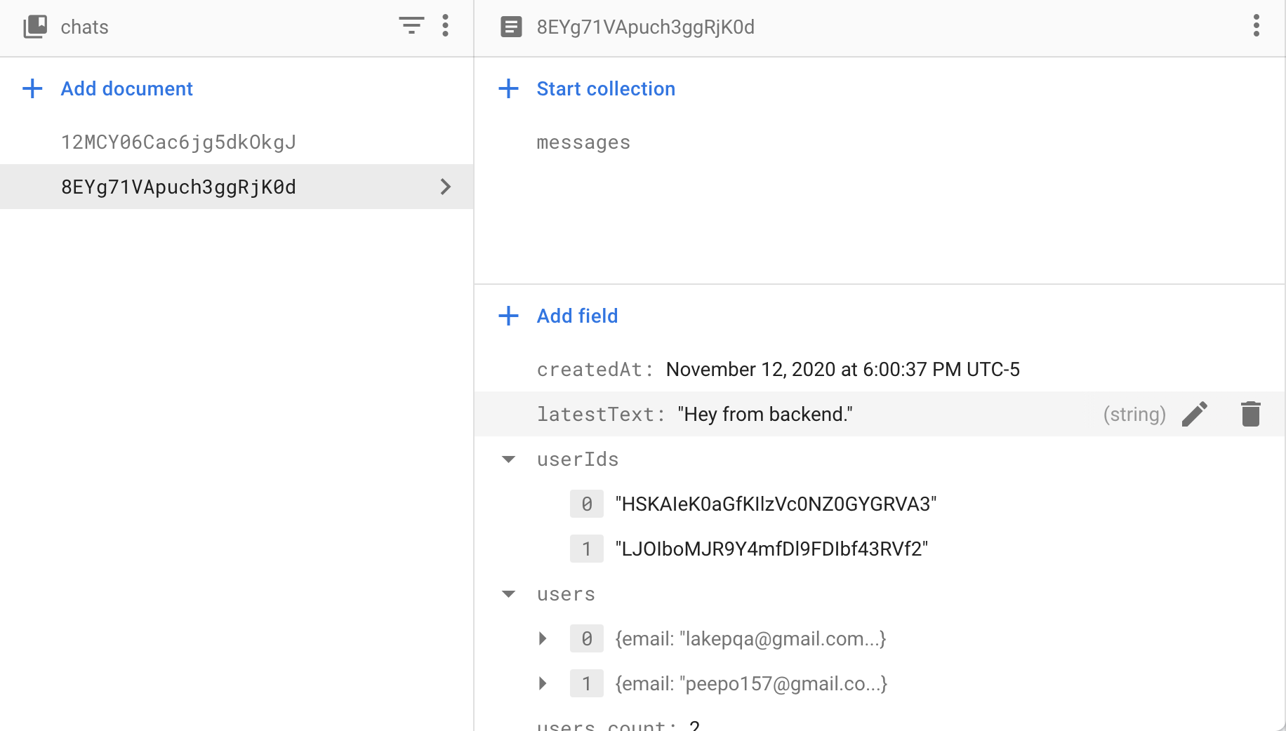
Backend Implementation (Send a message)

Slide 7
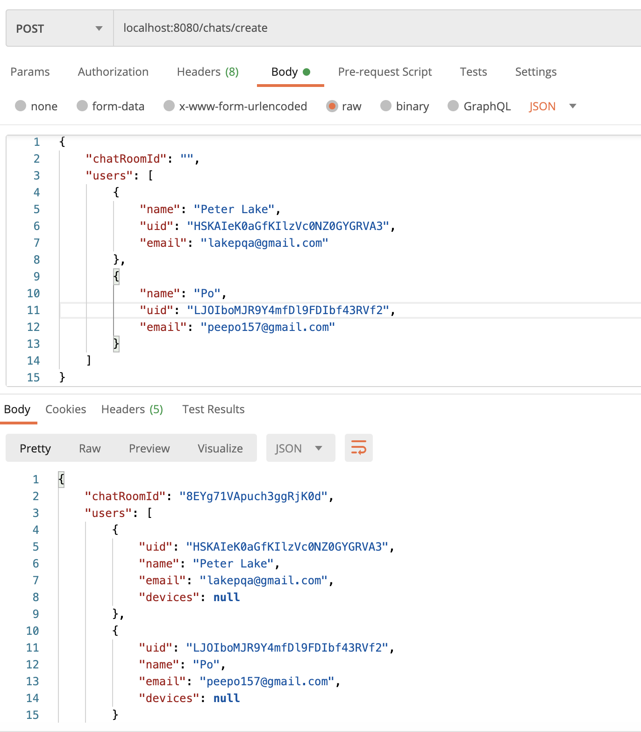
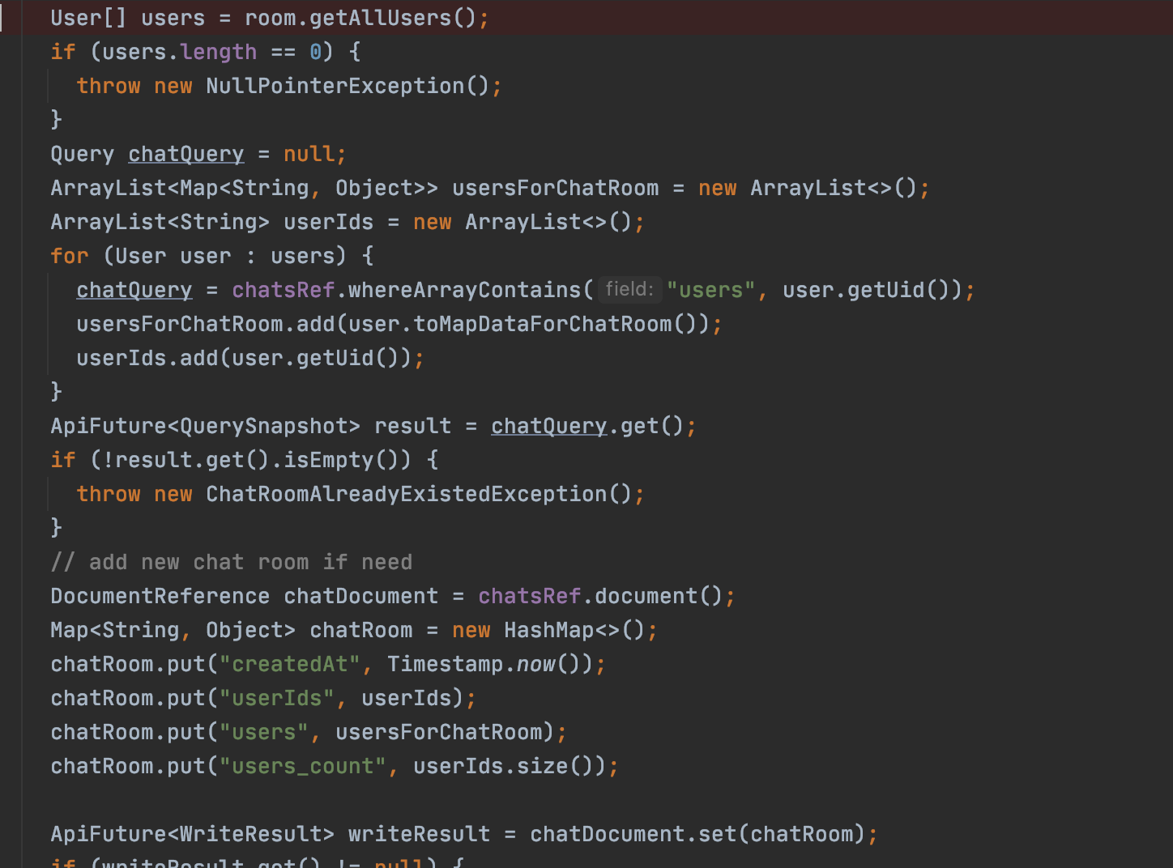
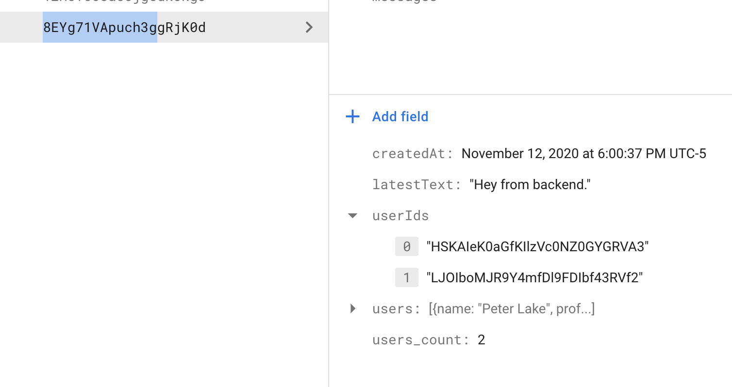
Backend Implementation (Create a chatroom)

Slide 8
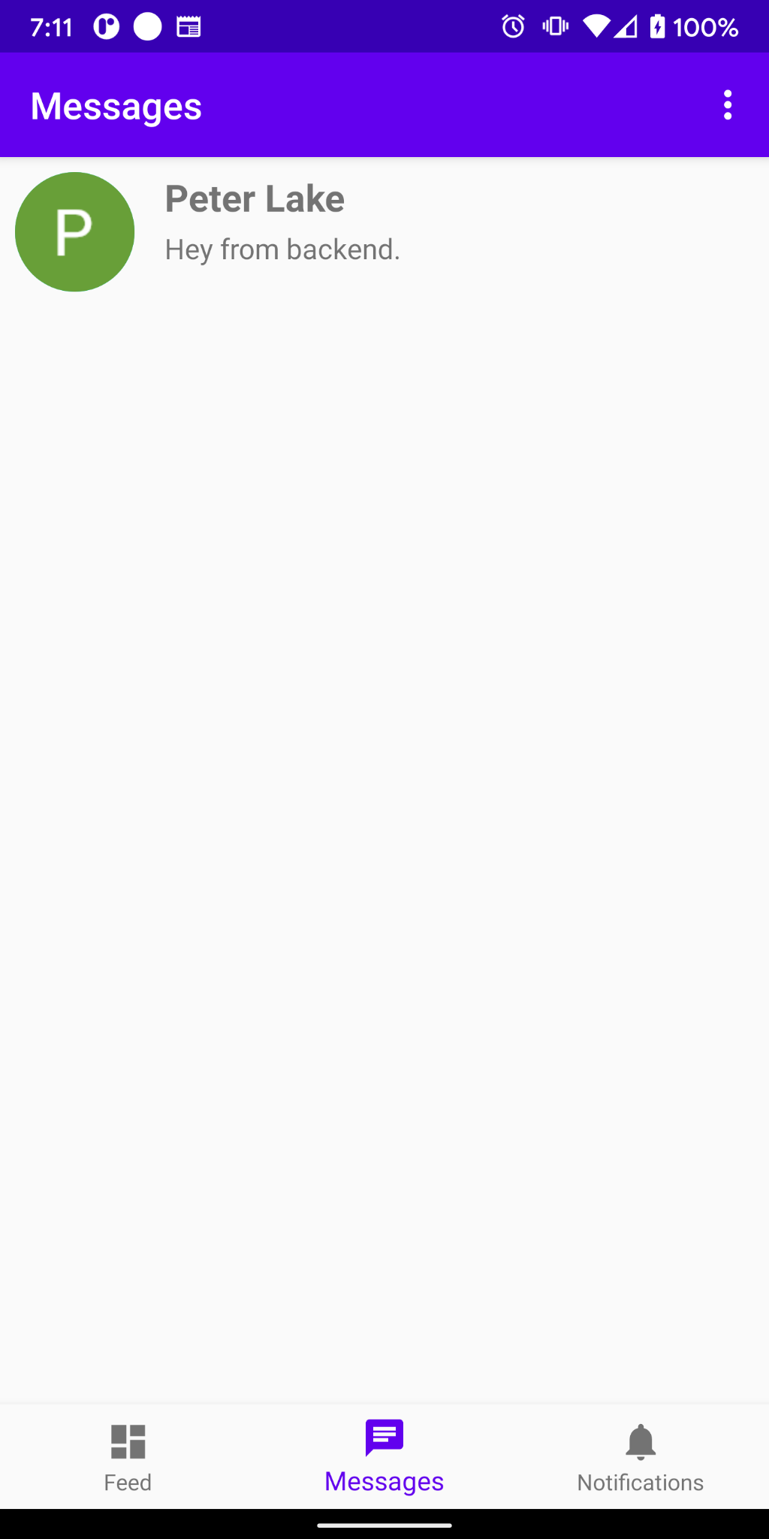
Backend Implementation (Create a chatroom)
Client now can fetch the chatroom, so client can have multiple chat room.

Slide 9
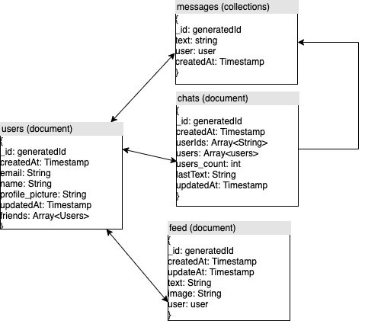
Data Design (noSQL document type)

Slide 10
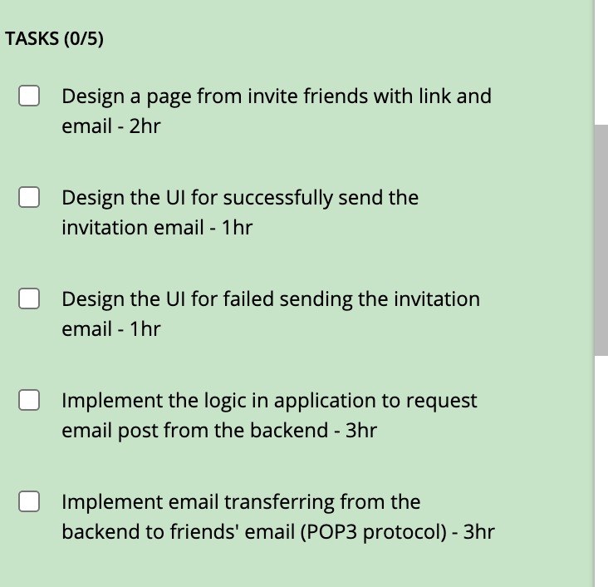
Query New Friend By Email
User stories: As a user, I want to be able to invite friends to Inner Circle via an email invitation so that I can add friends to the inner circle app without having to display a QR code.

Slide 11
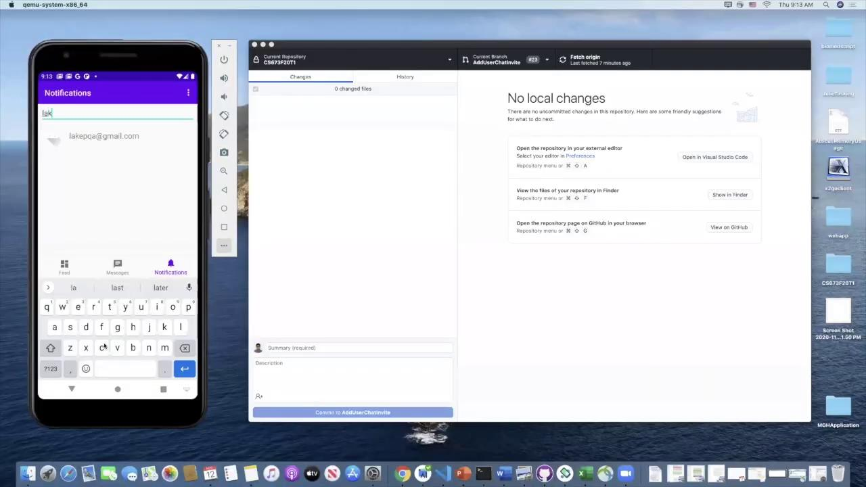
Query New Friend By Email - Implementation

Slide 12
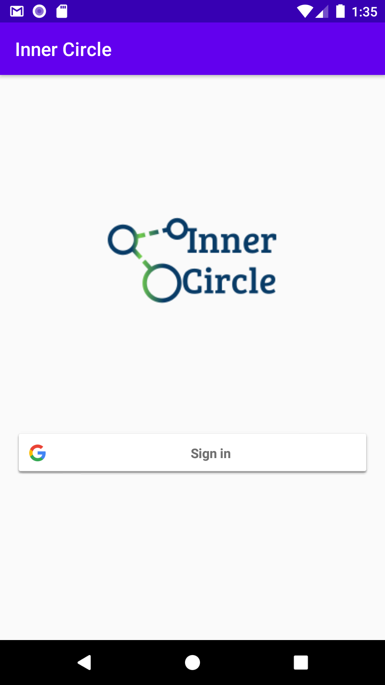
Testing and QA
Manual tests: login/logout behavior, individual chats
Unit tests: Partial test coverage of back end w/ JUnit
UI tests: Testing of login UI with Appium pending
Integration, additional unit & UI tests needed

Slide 13
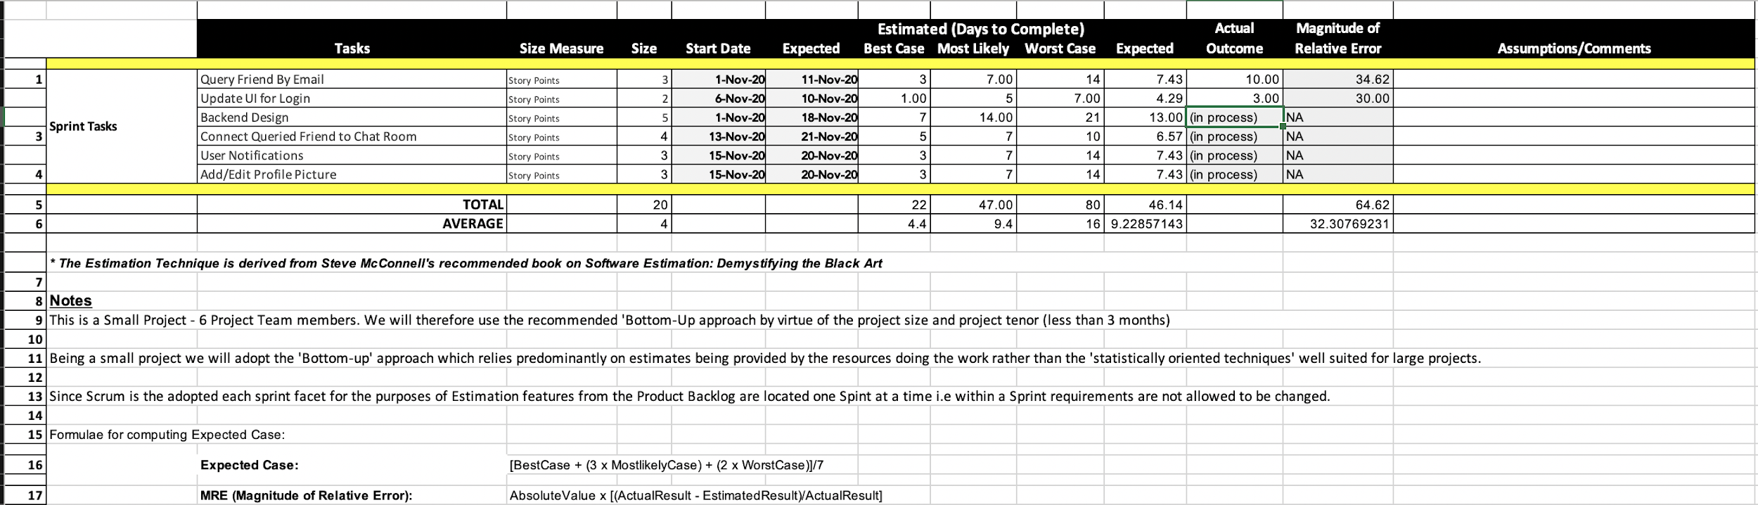
Project Management: Estimation
Management Note: Several of our stories have wrapped into the following week.

Slide 14
Configuration and Deployment
Everyone tries to commits code
Following git-flow mechanism
Adjusted work flow, minimize the conflict and coupling
Po - backend design and integration,
Michael & Peter - notification feature, query new friend by email
Ananya - update UI and design logo
Jian - editing user’s profile
…
s.

Slide 15
Security
Authentication - Google Login
Issue: we need more way to access, eg. email, facebook, etc.
Data encryption:
Privacy and security is in our DNA - end to end encryption
Generating cryptographic hashes (fingerprints) based on the communicating users’ public keys or shared private keys.
If the fingerprints match, there is in theory, no man in the middle.

Slide 16
Lessons Learned: Iteration 2
Organization: time management, all holding each other to more organized standards
Communication is never enough.
Challenges when working from anywhere. E.g. The Great Firewall of China, time difference;
Prepare for complication: stomach flu, last minute urgent, technical issue …
Improve efficiency: pair coding, small meeting …
How to re-organize when losing a team member

Slide 17
Q&A ^_^

